Slide 1
OSeMOSYS

Slide 2
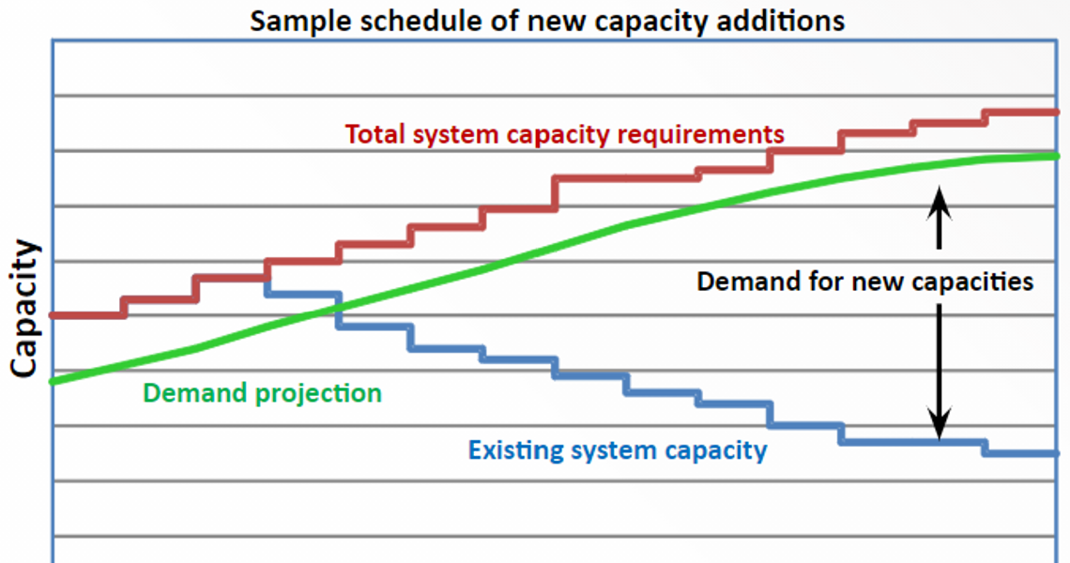

Slide 3
Input Parameters - Demand
SpecifiedAnnualDemand
Total specified demand for the year, linked to a specific ‘time of use’ during the year.
SpecifiedDemandProfile
Annual fraction of energy-service or commodity demand that is required in each time slice. For each year, all the defined SpecifiedDemandProfile input values should sum up to 1.
AccumulatedAnnualDemand
Accumulated Demand for a certain commodity in one specific year. It cannot be defined for a commodity if its SpecifiedAnnualDemand for the same year is already defined and vice versa.

Slide 4
Input Parameters - Performance
CapacityToActivityUnit | Conversion factor relating the energy that would be produced when one unit of capacity is fully used in one year.
CapacityFactor | Capacity available per each TimeSlice expressed as a fraction of the total installed capacity, with values ranging from 0 to 1. It gives the possibility to account for forced outages.
AvailabilityFactor | Maximum time a technology can run in the whole year, as a fraction of the year ranging from 0 to 1. It gives the possibility to account for planned outages.
OperationalLife | Useful lifetime of a technology, expressed in years.
ResidualCapacity | Remained capacity available from before the modelling period.
InputActivityRatio | Rate of use of a commodity by a technology, as a ratio of the rate of activity.
OutputActivityRatio | Rate of commodity output from a technology, as a ratio of the rate of activity.

Slide 5
Input Parameters – Technology Costs
CapitalCost | Capital investment cost of a technology, per unit of capacity.
VariableCost | Cost of a technology for a given mode of operation (Variable O&M cost), per unit of activity.
FixedCost | Fixed O&M cost of a technology, per unit of capacity.

Slide 6
Lots of parameters on energy storage

Slide 7
Constraints – Capacity vs Investment
CapacityOfOneTechnologyUnit | Capacity of one new unit of a technology. In case the user sets this parameter, the related technology will be installed only in batches of the specified capacity and the problem will turn into a Mixed Integer Linear Problem.
TotalAnnualMaxCapacity | Total maximum existing (residual plus cumulatively installed) capacity allowed for a technology in a specified year.
TotalAnnualMinCapacity | Total minimum existing (residual plus cumulatively installed) capacity allowed for a technology in a specified year.
TotalAnnualMaxCapacityInvestment[r,t,y] | Maximum capacity of a technology, expressed in power units.
TotalAnnualMinCapacityInvestment[r,t,y] | Minimum capacity of a technology, expressed in power units.
Notes:
Also activity based constraints

Slide 8
Input Parameters – RE generation targets
RETagTechnology | Binary parameter tagging the renewable technologies that must contribute to reaching the indicated minimum renewable production target. It has value 1 for thetechnologies contributing, 0 otherwise.
RETagFuel | Binary parameter tagging the fuels to which the renewable target applies to. It has value 1 if the target applies, 0 otherwise.
REMinProductionTarget | Minimum ratio of all renewable commodities tagged in the RETagCommodity parameter, to be produced by the technologies tagged with the RETechnology parameter.

Slide 9
Input Parameters - Emissions
EmissionActivityRatio | Emission factor of a technology per unit of activity, per mode of operation.
EmissionsPenalty | Penalty per unit of emission.
AnnualExogenousEmission | It allows the user to account for additional annual emissions, on top of those computed endogenously by the model (e.g. emissions generated outside the region).
AnnualEmissionLimit | Annual upper limit for a specific emission generated in the whole modelled region.
ModelPeriodExogenousEmission | It allows the user to account for additional emissions over the entire modelled period, on top of those computed endogenously by the model (e.g. generated outside the region).
ModelPeriodEmissionLimit | Annual upper limit for a specific emission generated in the whole modelled region, over the entire modelled period.

Slide 10
Ok, now onto model outputs….

Slide 11
Demand
Demand for one fuel in one time slice
Notes:
Storage -> LOADS of parameters

Slide 12
Capacity
NumberOfNewTechnologyUnits, integer | Number of newly installed units of technology t in year y, as a function of the parameter CapacityOfOneTechnologyUnit. | No unit
NewCapacity | Newly installed capacity of technology t in year y. | Power
AccumulatedNewCapacity | Cumulative newly installed capacity of technology t from the beginning of the time domain to year y. | Power
TotalCapacityAnnual | Total existing capacity of technology t in year y (sum of cumulative newly installed and pre-existing capacity). | Power

Slide 13
Activity (usage)
RateOfActivity[r,l,t,m,y] >=0 | Intermediate variable. It represents the activity of technology t in one mode of operation and in time slice l, if the latter lasted the whole year. | Energy (per year)
RateOfTotalActivity[r,t,l,y] >=0 | Sum of the RateOfActivity of a technology over the modes of operation. | Energy (per year)
TotalTechnologyAnnualActivity[r,t,y] >=0 | Total annual activity of technology t. | Energy
TotalAnnualTechnologyActivityByMode[r,t,m,y] >=0 | Annual activity of technology t in mode of operation m. | Energy
TotalTechnologyModelPeriodActivity[r,t] | Sum of the TotalTechnologyAnnualActivity over the years of the modelled period. | Energy
RateOfProductionByTechnologyByMode[r,l,t,m,f,y] >=0 | Intermediate variable. It represents the quantity of fuel f that technology t would produce in one mode of operation and in time slice l, if the latter lasted the whole year. It is a function of the variable RateOfActivity and the parameter OutputActivityRatio. | Energy (per year)
RateOfProductionByTechnology[r,l,t,f,y] >=0 | Sum of the RateOfProductionByTechnologyByMode over the modes of operation. | Energy (per year)
ProductionByTechnology[r,l,t,f,y] >=0 | Production of fuel f by technology t in time slice l. | Energy
ProductionByTechnologyAnnual[r,t,f,y] >=0 | Annual production of fuel f by technology t. | Energy
RateOfProduction[r,l,f,y] >=0 | Sum of the RateOfProductionByTechnology over all the technologies. | Energy (per year)
Production[r,l,f,y] >=0 | Total production of fuel f in time slice l. It is the sum of the ProductionByTechnology over all technologies. | Energy
RateOfUseByTechnologyByMode[r,l,t,m,f,y] >=0 | Intermediate variable. It represents the quantity of fuel f that technology t would use in one mode of operation and in time slice l, if the latter lasted the whole year. It is the function of the variable RateOfActivity and the parameter InputActivityRatio. | Energy (per year)
RateOfUseByTechnology[r,l,t,f,y] >=0 | Sum of the RateOfUseByTechnologyByMode over the modes of operation. | Energy (per year)
UseByTechnologyAnnual[r,t,f,y] >=0 | Annual use of fuel f by technology t. | Energy
UseByTechnology[r,l,t,f,y] >=0 | Use of fuel f by technology t in time slice l. | Energy
Use[r,l,f,y] >=0 | Total use of fuel f in time slice l. It is the sum of the UseByTechnology over all technologies. | Energy
Trade[r,rr,l,f,y] | Quantity of fuel f traded between region r and rr in time slice l. | Energy
TradeAnnual[r,rr,f,y] | Annual quantity of fuel f traded between region r and rr. It is the sum of the variable Trade over all the time slices. | Energy
ProductionAnnual[r,f,y] >=0 | Total annual production of fuel f. It is the sum of the variable Production over all technologies. | Energy
UseAnnual[r,f,y] >=0 | Total annual use of fuel f. It is the sum of the variable Use over all technologies.

Slide 14
Financials – Costing Variables (for caleb)
CapitalInvestment | Undiscounted investment in new capacity of technology t. It is a function of the NewCapacity and the parameter CapitalCost. | Monetary units
DiscountedCapitalInvestment | Investment in new capacity of technology t, discounted through the parameter DiscountRate. | Monetary units
SalvageValue[r,t,y] | Salvage value of technology t in year y, as a function of the parameters OperationalLife and DepreciationMethod. | Monetary units
DiscountedSalvageValue[r,t,y] | Salvage value of technology t, discounted through the parameter DiscountRate. | Monetary units
OperatingCost[r,t,y] | Undiscounted sum of the annual variable and fixed operating costs of technology t. | Monetary units
DiscountedOperatingCost[r,t,y] | Annual OperatingCost of technology t, discounted through the parameter DiscountRate. | Monetary units
AnnualVariableOperatingCost[r,t,y] | Annual variable operating cost of technology t. Derived from the TotalAnnualTechnologyActivityByMode and the parameter VariableCost. | Monetary units
AnnualFixedOperatingCost[r,t,y] | Annual fixed operating cost of technology t. Derived from the TotalCapacityAnnual and the parameter FixedCost. | Monetary units
TotalDiscountedCostByTechnology[r,t,y] | Difference between the sum of discounted operating cost / capital cost / emission penalties and the salvage value. | Monetary units
TotalDiscountedCost[r,y] | Sum of the TotalDiscountedCostByTechnology over all the technologies. | Monetary units
ModelPeriodCostByRegion[r] | Sum of the TotalDiscountedCost over all modelled years. | Monetary units

Slide 15
RE & Emissions
TotalREProductionAnnual | Annual production by all technologies tagged as renewable in the model. Derived from the ProductionByTechnologyAnnual and the parameter RETagTechnology. | Energy
RETotalProductionOfTargetFuelAnnual | Annual production of fuels tagged as renewable in the model. Derived from the RateOfProduction and the parameter RETagFuel. | Energy
AnnualTechnologyEmissionByMode | Annual emission of agent e by technology t in mode of operation m. Derived from the RateOfActivity and the parameter EmissionActivityRatio. | Quantity of emission
AnnualTechnologyEmission | Sum of the AnnualTechnologyEmissionByMode over the modes of operation. | Quantity of emission
AnnualTechnologyEmissionPenaltyByEmission | Undiscounted annual cost of emission e by technology t. It is a function of the AnnualTechnologyEmission and the parameter EmissionPenalty. | Monetary units
AnnualTechnologyEmissionsPenalty | Total undiscounted annual cost of all emissions generated by technology t. Sum of the AnnualTechnologyEmissionPenaltyByEmission over all the emitted agents. | Monetary units
DiscountedTechnologyEmissionsPenalty | Annual cost of emissions by technology t, discounted through the DiscountRate. | Monetary units
AnnualEmissions | Sum of the AnnualTechnologyEmission over all technologies. | Quantity of emission
ModelPeriodEmissions | Total system emissions of agent e in the model period, accounting for both the emissions by technologies and the user defined ModelPeriodExogenousEmission. | Quantity of emission

